Slide 1

Capstone Project Phase A
DoIt : An application for providing and consuming services with recommendation engine
Supervisor: Mr. Alex Keselman
Group Members: Aneel Amar & Shmuel Shaul
1

Slide 2








Motivation
Requester
Suppliers
Adam
Jenny
Alice
Bob
2
Notes:
Meet Jenny.
Jenny is a mother of 3 and works full time.
Jenny's daily routine is busy and exhausting and in addition to the routine she has several other tasks this morning:
1. Take the dog for a walk.
2. Go to the bakery and buy a cake for her older child's birthday.
3. Go to the post office and pick up an important package that arrived.
Most of us have encountered such a situation. I guess we would be happy if there was someone who could help us with all these tasks.
So there is someone like that.
Meet the boy Adam who is looking for money for the summer vacation.
He suggests to Jenny that he take out the dog instead.
Alice is a student looking for extra income. She just has an hour free from school and suggests to Jenny that she bring the cake.
And Bob is just at the post office and offers Jenny that he will pick up the package and bring it to her.
And that way Jenny will be able to come to work calm and happy.

Slide 3
Our Solution
01
What is DoIt?
03
Mobile Application
Platform for providing and consuming services based on user preferences using a recommendation engine.
Cross platform application develop with Flutter SDK.
02
Stakeholders
The user who requested the service.
The user who provides the service.
3
Notes:
We saw Jenny and the complex situation she was in, that's why we offer our solution: Doit that will make our life easier.
So, what is Doit, Doit is a Platform for providing and consuming services based on user preferences using a recommendation engine.
In more simple words, we have 2 kinds of users:
1. The user who requested the service, just like Jenny.
2. And The user who provides the service just like Adam, Bob and Alice.
Each user can do both things: provide and service.
How will the user use Doit? We would like to develop a mobile application for Doit.
Our application will be cross platform application, which means that both iOS and Android users can use it.
We choose to develop the front-end with Flutter, since we are students and lack of time, we wanted take advantage of the concept of code once and use it on multiple Operating systems.

Slide 4




Existing Solution
Facebook Groups
Thumbtack
UrbanClap
Bizzby
4
Notes:
1. Today, there is a group on Facebook for any topic. in Israel, for example, there is a group called "need something"? which counts thousands of people. In this group, people post demands or questions and other people provide the required services/answers.
The problem with it, is that it is not dedicated for this purpose.
2. Thumbtack allows users to find the right people for all their projects. The service providers are professionals.
3. UrbanClap is a large home service provider that connects customers to service professionals to meet their daily needs. Again – professionals only.
4. Bizzby, Services right from house cleaning to gardening, junk removal, health, and beauty, to the child and personal care. Kind of similar idea, but bad implementation. Only for android and ranked in google store 2/5 stars.
As you can see most of the existing solutions are for professional providers, we offer a different model.

Slide 5




Recommendation System
Content Based Filtering
Content-based filtering is a method of recommending items to users based on their past preferences and behavior.
It uses the characteristics or attributes of the items themselves, rather than the behavior of other users, to make recommendations.
It is also known as "content-based recommendation.“
Our system will provide recommendations based on self preferences and distance.
Adam
5
Notes:
Like any technology company we push AI in the presentation.
But in this case, we really intend to use a recommendation system model to improve the user experience.
As we will also see later, one of the challenges was to choose which type of recommendation system to choose. Finally, we chose Content Based Filtering.
That means that when user sign-up to our app, he choose the categories he likes and the system offer him service to supply based on his preferences, distance and usage history.

Slide 6

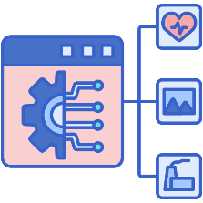



Features
Internal Chat
Recommendation System
Ranking System
Service History
Notifications
6
Notes:
Here are some of the main features of our application:
1. Internal chat: a chat that will allow users to communicate with each other within the application and not in different applications such as WhatsApp.
2. Recommendation system: exactly as we explained in the previous slide.
3. Rating system: As with any service platform, we will allow users to rate the service providers and thus provide a motive for satisfying services at a higher level.
4. Service history: Each user will be able to view previous services they have consumed/provided with all the relevant details.
5. Notifications: in order to improve the user experience, as soon as there is an important event such as a user wishing to provide you with a service or a new service that someone requests has been published, the user will receive a notification.

Slide 7
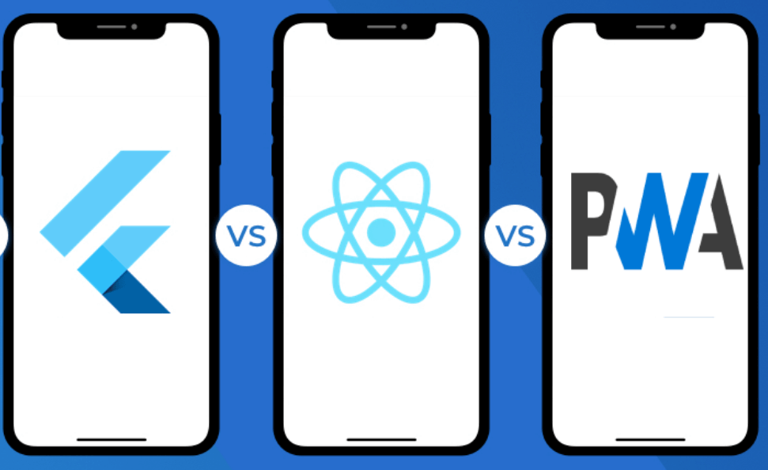

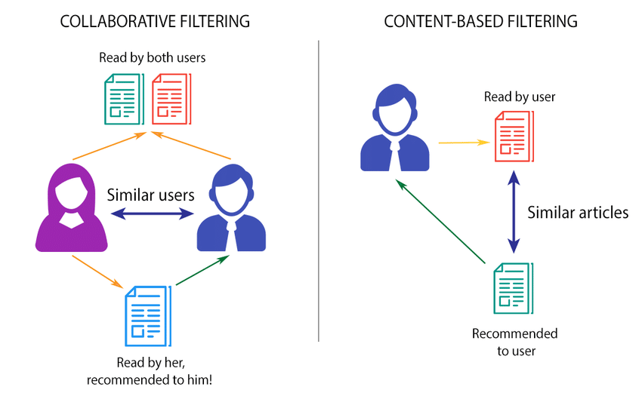
Challenges & Constraints
Choose Development Platform and learn it
Flutter VS React Native VS PWA
UI/UX
How to create user-friendly app
Recommendation engine type
Choose the right type of model for our app
7
Notes:
As part of the engineering process, we encountered several challenges:
Choose Development Platform: At first, we were debating between Flutter and React Native because we wanted a cross platform SDK, then Alex suggest us to use PWA. We some research and eventually we decided to go with flutter, since we wanted to learn something new that getting a lot of popularity in recent years.
UI/UX: we are software engineers not a UI/UX designers, so one of the main aspect of successful app is the UX.
Recommendation engine type: as we said before we needed to choose between content based filtering and collaborative filtering and eventually we choose content based as the more suitable solution to our app.

Slide 8



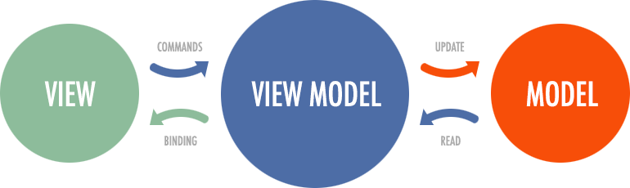
Constraints
Learn Mobile Development
8
Notes:
Our main constraint will be to learn new technologies that we have not encountered yet.
For the client side we will have to learn Flutter. For the server side- firebase And for the software architecture we will have to learn how to implement MVVM.
Before starting the implementation stage, we will have to study all the components well.

Slide 9





Conceptual Diagram
Create new request
Requester
Chat
Ask for recommended services
Recommendation system
Send recommended services
Supplier
9

Slide 10
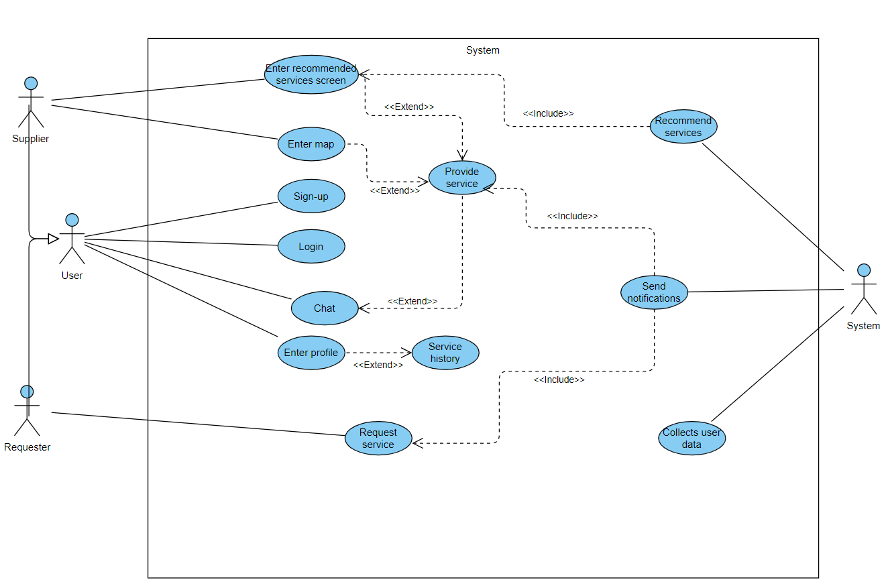
Use Case Diagram
10

Slide 11
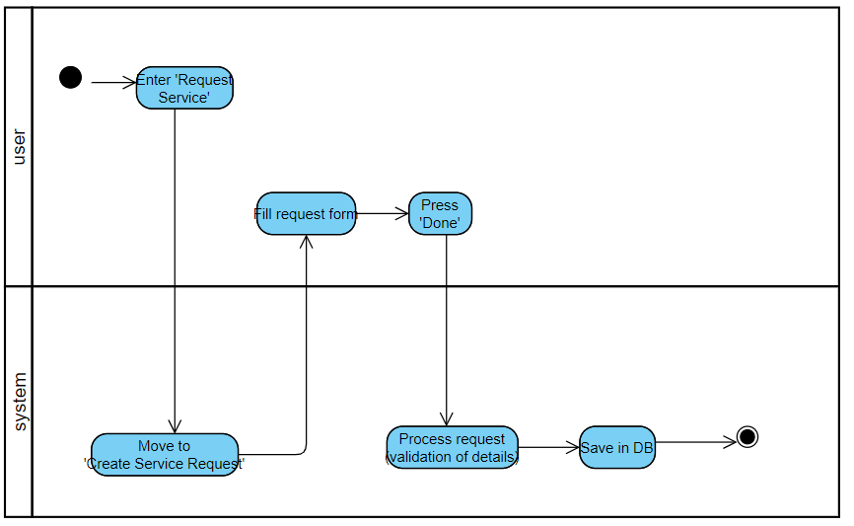
Activity Diagram
Request Service
11

Slide 12
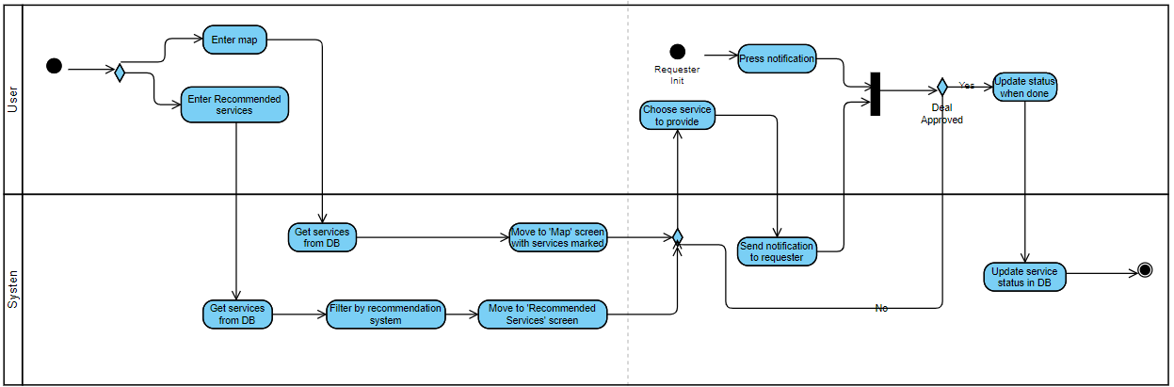
Activity Diagram
Provide Service
12

Slide 13
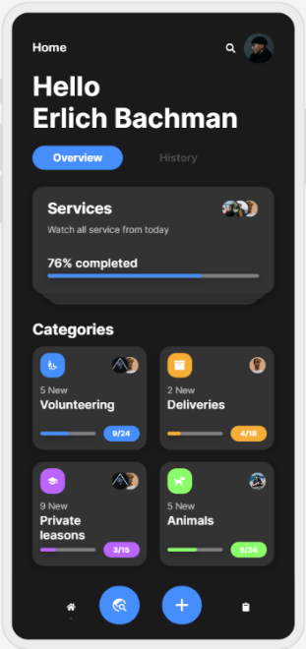
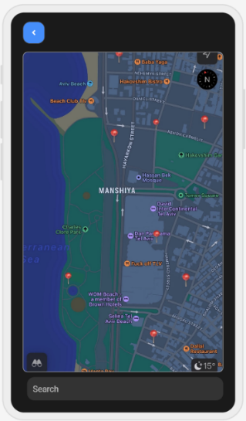
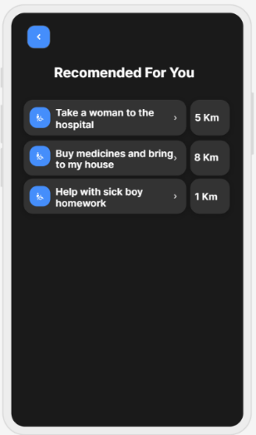
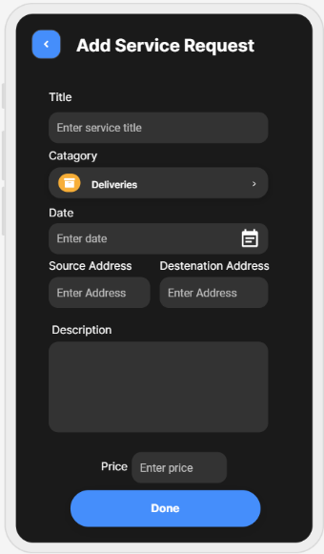
UI Characterization
Main Screen
Search Service
Recommendations
Create Request
13

Slide 14
Verification Plan
we chose to work in Agile development method, thus, Every sprint we test the features that were developed during the sprint.
Req. Number | Requirement | Description | Expected Result
1 | The system allows users to sign-in to the system. | The user has to enter the app and press sign-in on the home page. Then enter his details. | System validates the details and if they valid, save the details in the DB. Else show an error message on the screen.
2 | The system allows the user to login to the system. | The user has to enter the app and press login on the home page and insert credentials. | The system validates the credentials, if valid and user exist, move the user to the home screen.
3 | The system allows the user to enter his profile page. | The user has to click on his profile picture. | The system switch screen to the user profile screen.
4 | The system allows user to enter a map that shows services. | The user has to press on the map icon in the main screen. | The system switch screen to the map screen and show marked services on the map.
5 | The system allows the user to see details about services on map. | The user has to click on a service he wants the details about. | The system raise a popup window with detail about the service the user pressed on.
14

Slide 15
Verification Plan
Req. Number | Requirement | Description | Expected Result
6 | The system allows the user to choose service from the map. | The user has to click on ‘provide’ button inside the service popup window. | The system open a chat with the requester in order to allow the users to agree on a deal.
7 | The system allows the user to watch a recommended services list. | The user has to click the ‘recommended for you’ button on the map screen. | The system will switch screen to the ‘recommended for you’ screen and show a list of recommended service that provided by the recommendations system.
8 | The system allows the user to see details about services on list. | The user has to click on a service he wants the details about. | The system raise a popup window with detail about the service the user pressed on.
9 | The system allows the user to add new service request. | The user has to click on the ‘Add service request’ button in the main screen, fill the request form a press done. | The system validate the details. If valid, save on DB and send related notifications. Else show an error message on the screen.
10 | The system allows the user to communicate with other users. | The user has to enter the chat room form different user profile or by providing service. | The system switch to the chat screen with the requested user.
11 | The system allows the user to rank other users. | The user has to choose rating on different user profiles. | The system will save the rank in the DB and calculate the new average rating.
12 | The system will be able to send notifications. | Notification will be sent by system after providing event or offering service event. | The system will send notification to the destination user with the relevant details.
13 | The system will be able to recommend on services to users according to user preferences. | The system will be using a model to filter a service according to user preferences | The system will use the recommendations system to generate recommended services list and show the list in the ‘recommended for you’ screen.
15

